Slide 1
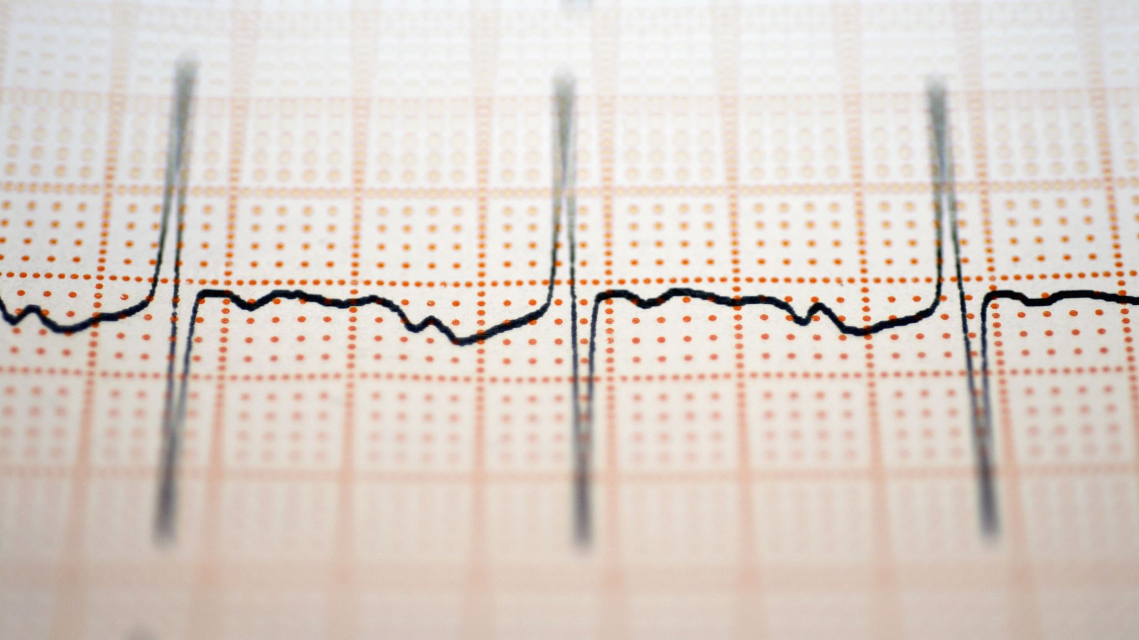
Heart Disease Diagnostic Analysis

Slide 2
INTRODUCTION
Health is real wealth in the pandemic time we all realized the brute effects of covid-19 on all
irrespective of any status. The data extracts various information such as
Heart disease rates, Heart disease by gender, by age. As cardiovascular diseases continue to be a leading cause of global morbidity and mortality, this project underscores the importance of early diagnosis and data-driven approaches for effective healthcare.

Slide 3
DETAILS OF DATA
The given dataset contains the records of 1025 patients. It has 14 attributes including target variable.All the variables are numerical.There is no null values but contained 723 duplicated values and they are dropped. After removing the duplicated values there are 302 rows and 14 attributes. Outliers are presented in the varoables like trestbps,chol,thalach,oldpeak,ca and thal and they are cleaned.Now the shape of the data become (261,14).

Slide 4
MAIN KPI’s
Heart disease rates: This can be calculated by dividing the number of people with heart disease by the total population.
Heart disease by gender: This can be calculated by comparing the heart disease rates for men and women.
Heart disease by age: This can be calculated by comparing the heart disease rates for different age groups.

Slide 5
The average resting blood pressure of an individual is 129 whereas the maximun value goes upto 170.
The maximum heart rate received varies from 88 to 202 and average heart rate is 150.
Age of the group varies from 29 to 77 and the mean age is 53
The highest cholestrol level is 360 and the lowest is 242.
restecg can be 3 type.
Resting Blood Pressure of individuals vary between 94 to 200.
There are 4 types of chest pain.
exercise induced angina has 2 types (1 = yes; 0 = no)
ST depression values will be more for unhealthy people and it ranges from 0 to 4 and average stress level is 0.9
slope can be of 3 types
No of major vessels can be 0-3
Thalium stress can be 3 types

Slide 6
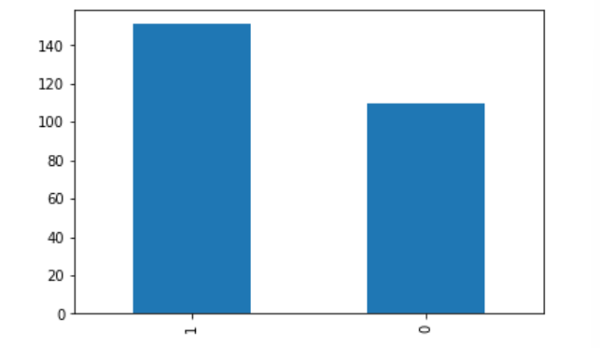
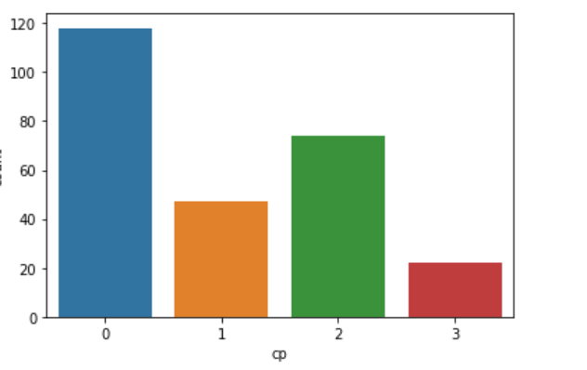
151 people has heart attack and 110 has no heart attack out of 261 patients. Out of 261 people,179 are male and 82 are female
People with typical agina chest pain are the most, whereas of count of people with asymtomatic chest pain is lowest

Slide 7
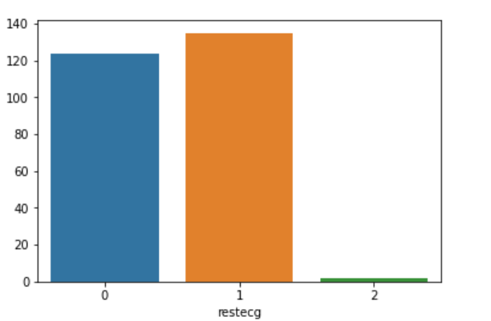
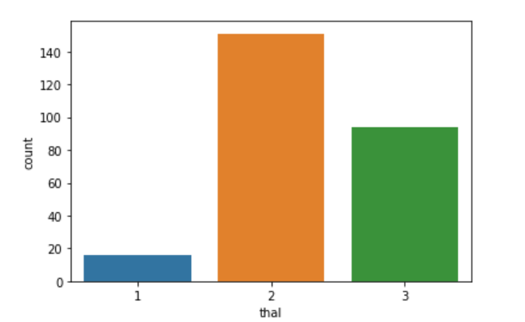
People which non-normal heart beat are more in number and no of people with definite left ventricular hypertrophy is negligible in comparision to others. Among 261 people 228 are non-diabetic and 33 are diabetic
More number of patients have thallium stress level as reversable defect

Slide 8
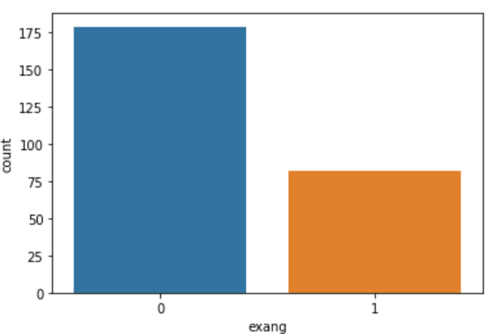
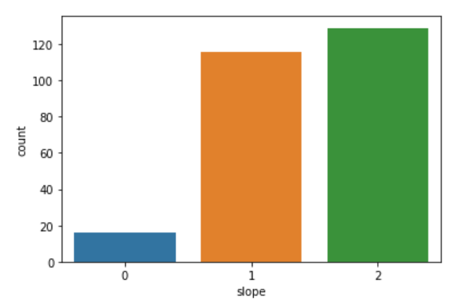
Most people has no exercise induced angina.
Most of the people are Downslopins which shows signs of unhealthy heart

Slide 9
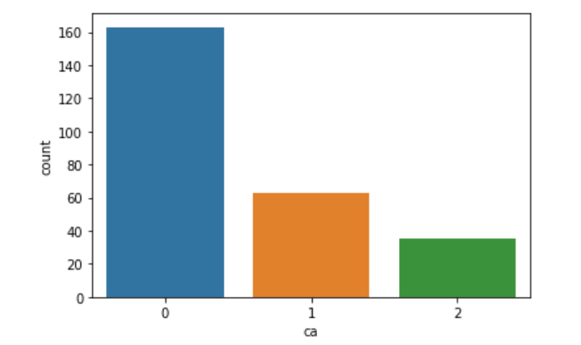
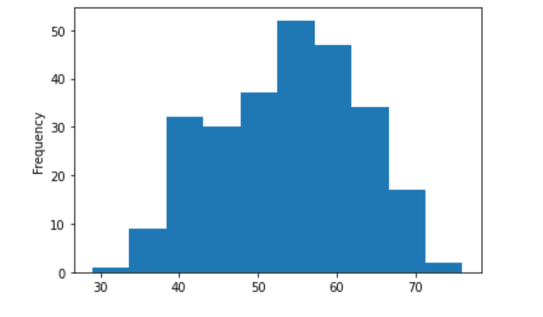
The no of major vessels is 0 for most of the people.
Most patient are between the age (45-60)

Slide 10
As age increases from 29 the no of patients of heart attack also increases and reached its peak level at age 54 and it decreases when it comes to the age 76.Age groups 41-54 have high proportion of heart attacks. So we can say that adults are more prone to heart attack.
Heart attack is more for male than female.
People with chest pain type 2 are more prone to heart attack when compared to other chest pain categories.
Higher number of heart disease patient without diabetes. This provide an indication that fbs might not be a strong feature differentiating between heart disease a non-disease patient. As blood pressure increase from 120 there is chance of heart attack.
Downslopians are more prone to heart attack.
People with RESTECG 1 are more prone to heart attack.
Individuals with heart disease tend to have higher maximum heart rates on average compared to those without heart disease. Increasing in heart rate will have high chances of heart attack

Slide 11
‘cp’, ‘thalach’, ‘slope’ shows good positive correlation with target
‘oldpeak’, ‘exang’, ‘ca’, ‘thal’, ‘sex’, ‘age’ shows a good negative correlation with target
‘fbs’ ‘chol’, ‘trestbps’, ‘restecg’ has low correlation with our target

Slide 12
Age groups "40-49" & "50-59" have high proportion of heart attacks.
Increasing in heart rate will have high chances of heart attack.
People with RESTECG 1 are more pronne to heart attack follwed by RESTECG 0 and RESTECG 2.
People with chest pain type 2 are more prone to heart attack when compared to other chest pain categories.

Slide 13
THANK YOU

